Slide 1
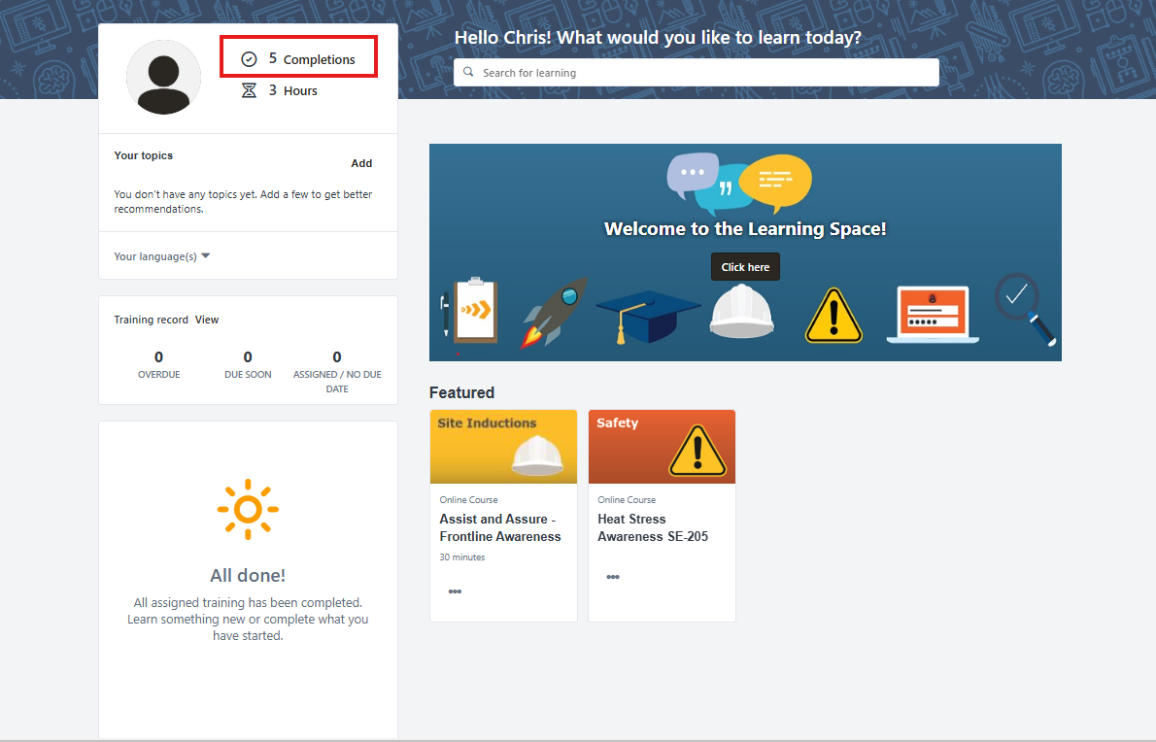
Go into your account and select your ‘Completions’

Slide 2
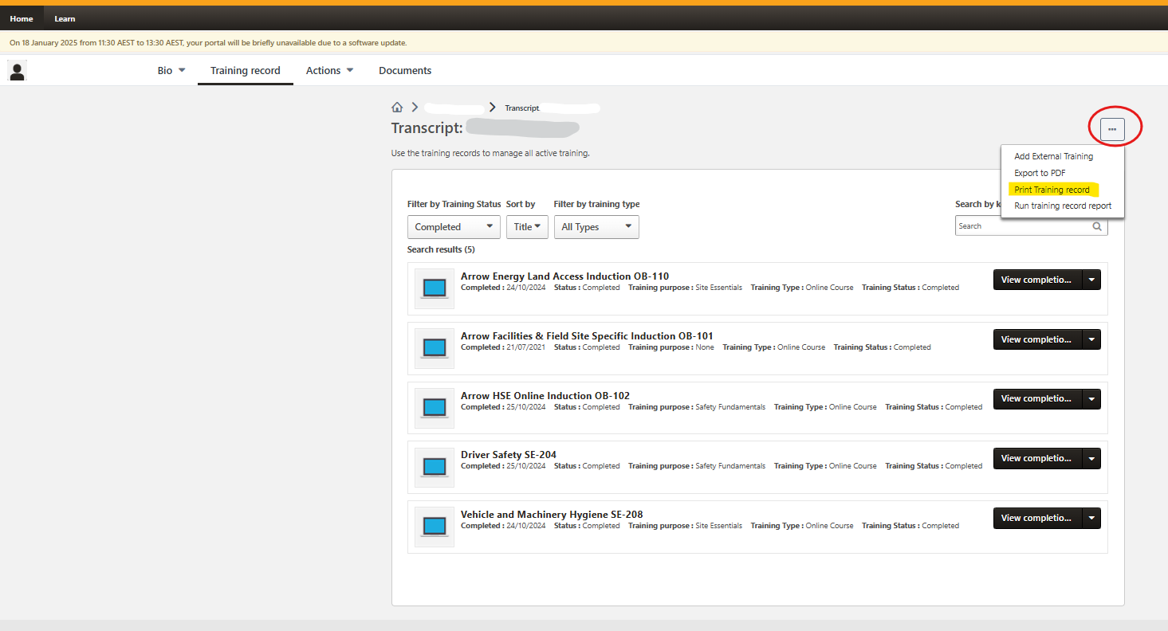
When completions opens, select 3 dots in box on top right and select Print Training Record

Slide 3
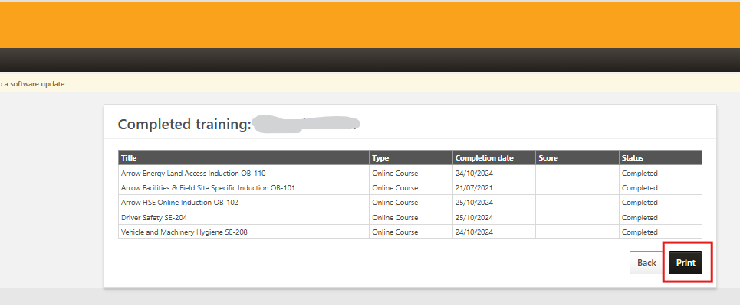
Print training record to your local printer or to PDF.

Slide 4
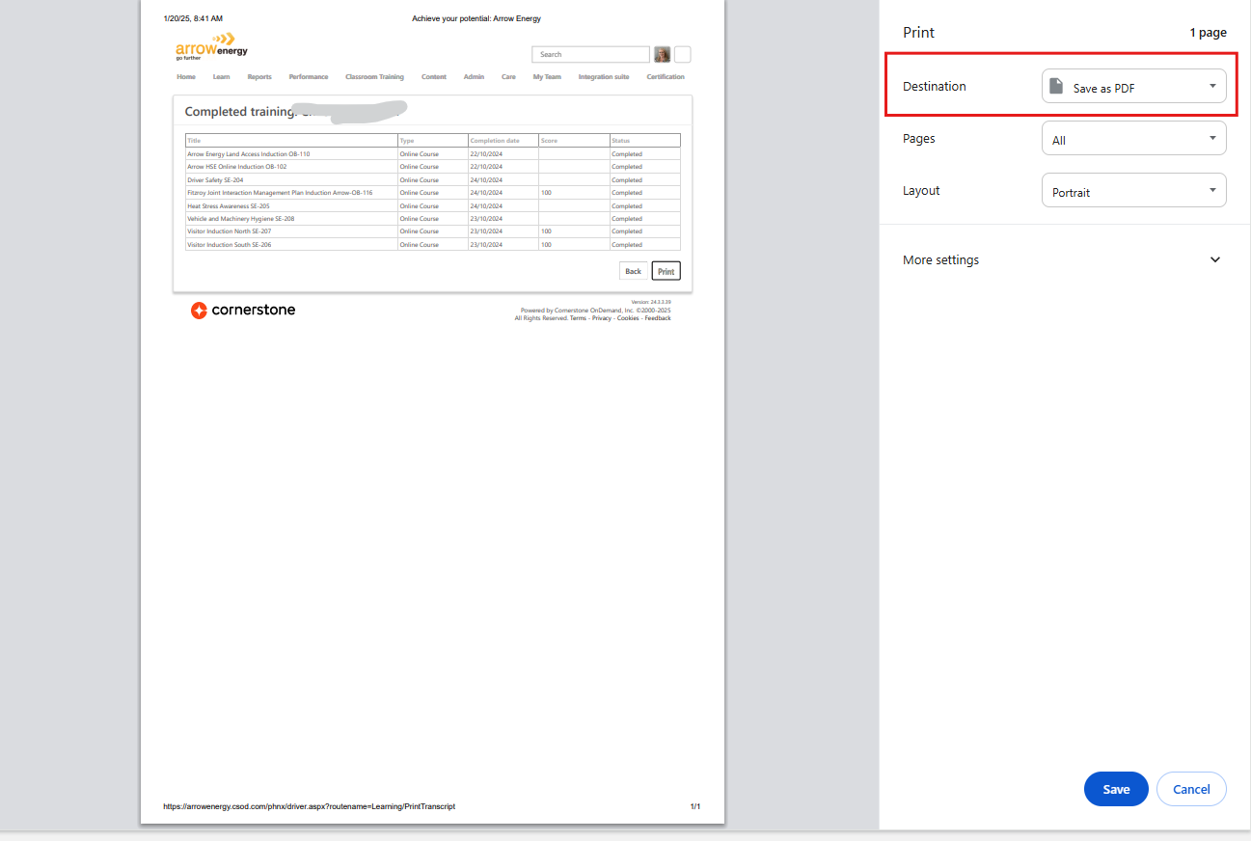
If saving document to device, change printer destination to Save as PDF. Send to new provider.

Slide 5
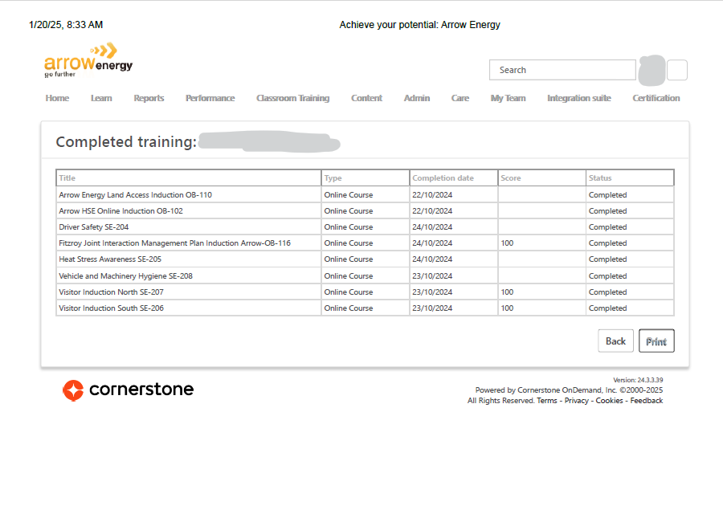
Example: Printed Training Record

Slide 6
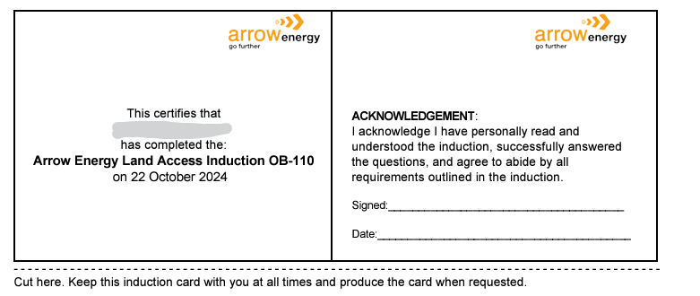
Example: Printed Certificate

